Slide 1
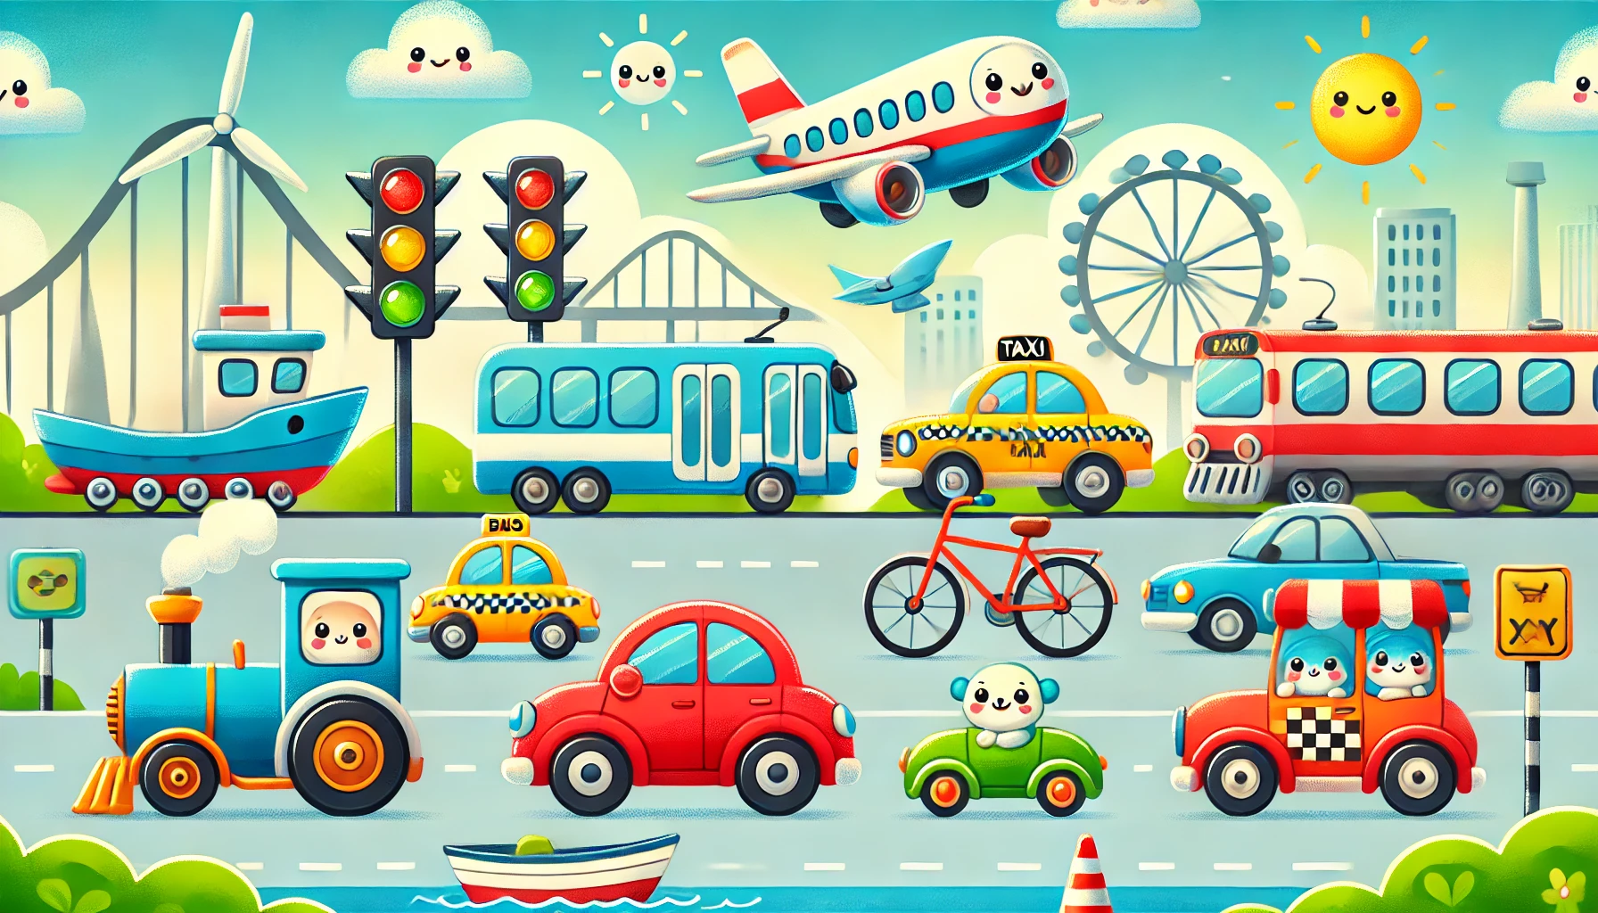
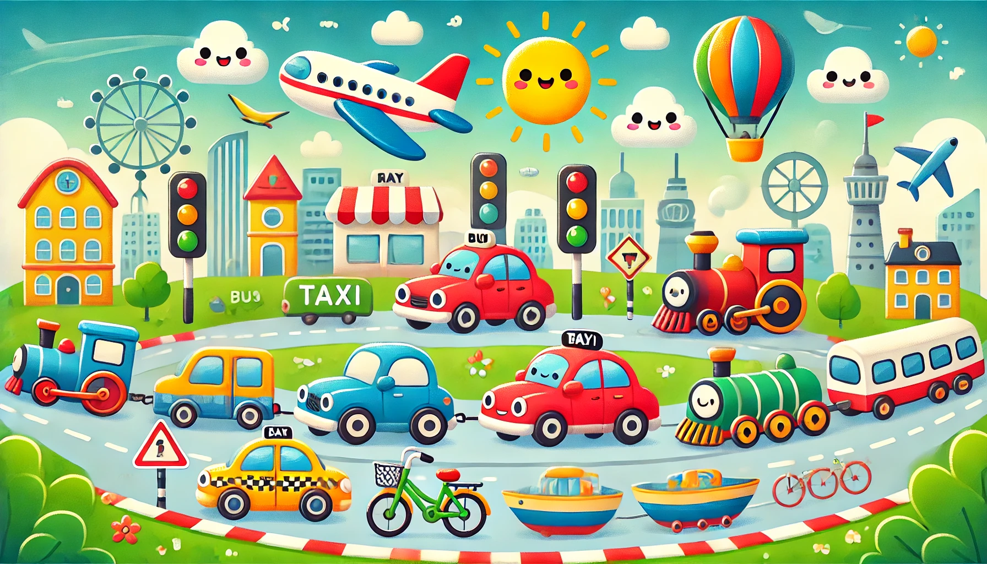
Transport
Livre de Coloriage

Slide 2


Tracer & Colorer
Transport
Train

Slide 3


Tracer & Colorer
Transport
Voiture

Slide 4


Tracer & Colorer
Fourgon
Transport

Slide 5


Tracer & Colorer
Transport
Bus

Slide 6


Tracer & Colorer
Transport
Camion de pompier

Slide 7


Tracer & Colorer
Transport
Avion

Slide 8
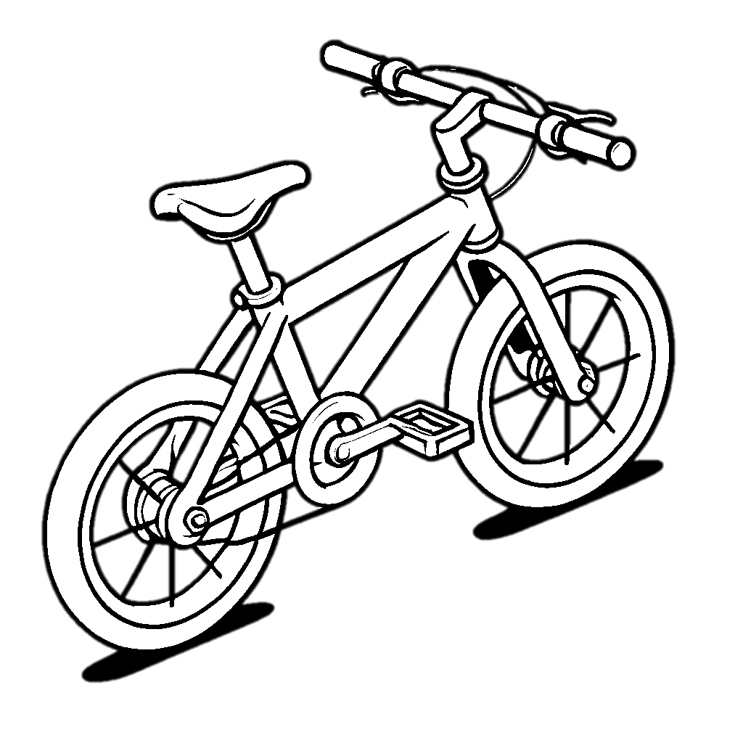

Tracer & Colorer
Transport
Vélo

Slide 9


Tracer & Colorer
Transport
Tricycle

Slide 10



Tracer & Colorer
Kayak
Transport

Slide 11


Tracer & Colorer
Transport
Sous-marin

Slide 12


Tracer & Colorer
Radeau
Transport

Slide 13


Tracer & Colorer
Transport
Montgolfière

Slide 14
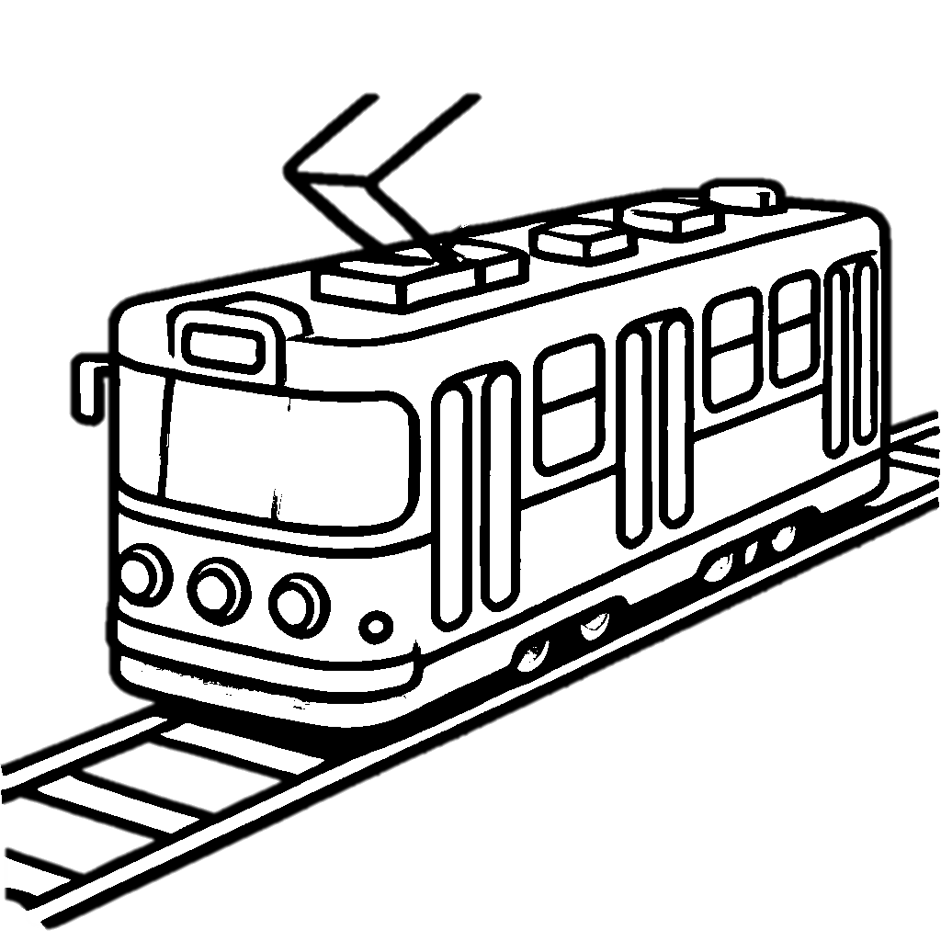

Tracer & Colorer
Tram
Transport

Slide 15

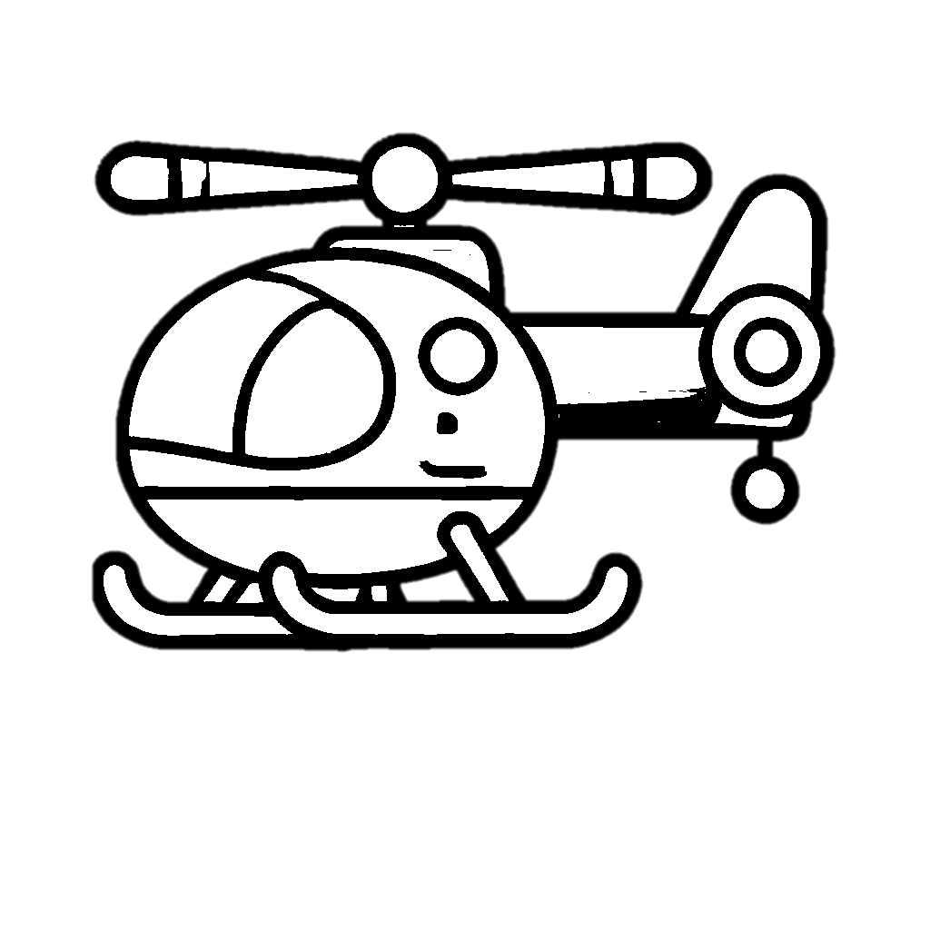
Tracer & Colorer
Transport
Hélicoptère

